Slide 1

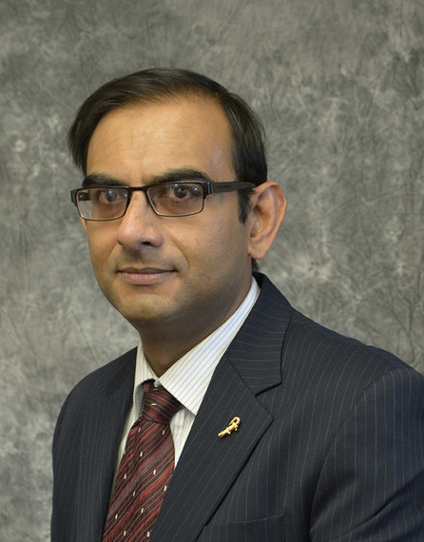
Introduction to Cloud Computing with R in Google Cloud and Amazon Web Services practicum session
Sounak Chakraborty
Associate Professor, Department of Statistics
http://faculty.missouri.edu/chakrabortys/

Slide 2
Practicum task
If you have an ongoing R project which you want to migrate in cloud you are welcome to do that in this practicum. For that you will need your R code and data files.
if you don’t have your own R project for practicum use the given toy practicum.
The toy practicum fits a Kernel Import Vector Machine model which is a sparse representation of SVM.
the R code file practicumcode.R is the main one to run. It will call subfunction practicumcodebklr-bivm.r which contains the main model. It will also call subfunction practicumdatageneration.R which simulates a toy data set.
Output of the practicum will be model output and a plot.
The main reason for the practicum is to let you work unassisted following the instructions and complete the task of running R/Rstudio in cloud. This will make you feel less intimidated about working in cloud environment.

Slide 3
Practicum task with google cloud platform: Linux shell version
Create your own vm in google cloud, chose machine architecture, os and all other options as discussed in the previous sessions.
Launch your vm. Install r in it. Install necessary packages in it.
Upload r code and data files.
Run your r script in GCP. Download outputs from cloud.
Can you parallelize your code using the functions we learnt in previous sessions.
After completion make sure to stop VM. Also if you want you can delete the VM.

Slide 4
Practicum task with google cloud platform: RStudio version
Create and Launch RStudio server in GCP using the RStudio Pro GCP.
Change the password for your Rstudio server. Install necessary R packages.
Upload r code and data files.
Run your r code. Download outputs from cloud from Rstudio server.
After completion make sure to stop VM. Also if you want you can delete the VM.
Check your google billing to see how much you have used so far.

Slide 5
Practicum task with AWS: Rstudio version
Create your own vm in AWS EC2 based on a predefined AMI.
Launch your RStudio Server in AWS. Install necessary packages in it.
Upload r code and data files.
Run your r code. Download outputs from cloud from RStudio server.
Stop and also terminate the AWS instance after you are done.

Slide 6

THANK YOU SOUNAK CHAKRABORTY CHAKRABORTYS@MISSOURI.EDU http://faculty.missouri.edu/chakrabortys/

